Slide 1
Ultrasound and
Disaster Triage
Dan O’Brien, MD FAAEM, FACEP
Associate Professor Emergency Medicine
University of Louisville School of Medicine
Fire Surgeon, Louisville Division of Fire
SWAT Physician, Louisville Metro Police SWAT Team

Slide 2
DIsclosure
I have no conflicts of interest nor any commercial interests in any of the services or devices mentioned in this presentation

Slide 3
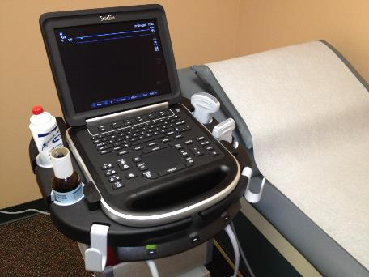
The Future
Utilization of ultrasound in the emergency department continues to grow
Devices are getting more affordable, portable and user-friendly and have become well suited for use in the prehospital environment
Well suited for use in mass casualty incidents (MCIs)
Notes:
during mass casualty and disaster management. Currently
available ultrasound devices are more affordable, portable,
and feature user-friendly interfaces, making them well
suited for use in the demanding situation of a mass casualty
incident (MCI) or disaster triage. We have reviewed the
existing literature regarding the application of sonology in
MCI and disaster scenarios, focusing on the most promising
and practical ultrasound-based paradigms applicable in
these settings.
Keywords CAVEAT protocol
and intensive care units [1 –5 ]. As the utilization of sonography
grows, so does our understanding of its applications
and limitations. One of the disciplines in which ultrasound
has been researched the most is the care of the trauma
patient

Slide 4
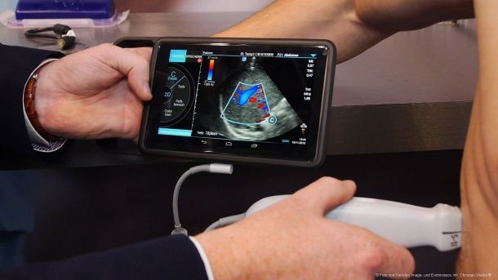
Ultrasound technology
Smaller
Cheaper
Easier
More reliable

Slide 5
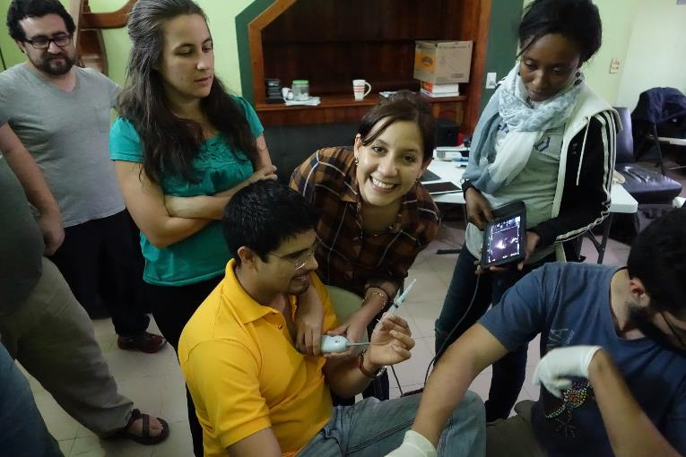
Small Accurate Easy

Slide 6
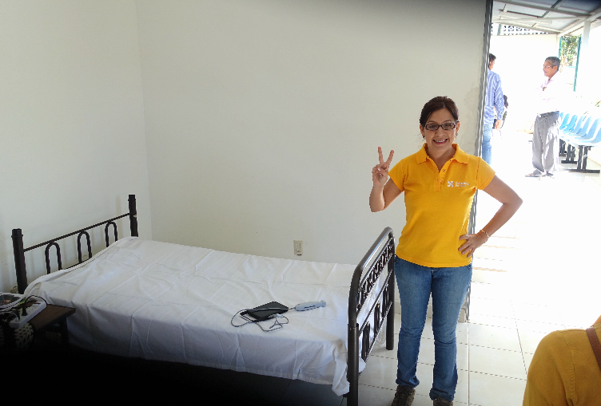
Chiapas Mexico

Slide 7
Ultrasound
FAST is now a key component for the evaluation of trauma
  Quickly identify intraperitoneal blood
Pneumothorax/hemothorax
    Sensitivity > 90%
    Specificity 100%
Can detect long bone fractures
Can assess etiology of hemodynamic instability
Notes:
The focused assessment with sonography for trauma
(FAST) is now a key component of the trauma care algorithm
and has reduced the need for other, more invasive,
diagnostic adjuncts such as diagnostic peritoneal lavage
[11 ]. In addition to the FAST exam being used to identify
intrapericardial and intraperitoneal blood, ultrasound has
been described as a useful adjunct in the identification of
pneumothoraces [12 , 13 ] and hemothoraces [14 , 15 ] with a
detection rate of 92 % and specificity of 100 % [12 ]. Ultrasound
can also detect bony injuries such as rib and longbone
fractures [16 –18 ], and is helpful in the evaluation of
the hemodynamically unstable patient by examining the
static and dynamic behavior of the inferior vena cava (IVC)
and other central veins to assess the intravascular volume
status [19 –23 ].
As the cumulative experie

Slide 8
Locations
International Space Station
Air medical transport
Front-line combat teams
Mass casualty incidents
Sarkisian AE, et al. Sonographic screening of mass casualties
for abdominal and renal injuries following the 1988 Armenian
earthquake. J Trauma. 1991;31(2):247–50.
Notes:
International Space Station [55 ], in ground
and aeromedical transport [3 , 56 ], mass casualty incidents
[1 ], and front-line combat surgical teams [57 –60 ].

Slide 9
Triage
Ethical Justification
  This is one of the few places where a "utilitarian rule" governs medicine: the greater good of the greater number rather than the particular good of the patient at hand.
  This rule is justified only because of the clear necessity of general public welfare in a crisis.
A. Jonsen and K. Edwards, “Resource Allocation” in Ethics in Medicine, Univ. of Washington School of Medicine, http://eduserv.hscer.washington.edu/bioethics/topics/resall.html

Slide 10
Primary Disaster Triage
Goal: to sort patients based on probable needs for immediate care and to recognize futility.
Assumptions:
  Medical needs outstrip immediately available resources
  Additional resources will become available with time

Slide 11
Primary Triage
Triage based on physiology
  How well the patient is able to utilize their own resources to deal with their injuries
  Which conditions will benefit the most from the expenditure of limited resources

Slide 12
Secondary Disaster Triage
Goal: to best match patients’ current and anticipated needs with available resources.
Incorporates:
  A reassessment of physiology
  An assessment of physical injuries
  Initial treatment and assessment of patient response
  Further knowledge of resource availability

Slide 13
Secondary Disaster Triage
Goal is to distinguish between:
  Victims needing life-saving treatment that can only be provided in a hospital setting.
  Victims needing life-saving treatment initially available on scene.
  Victims with moderate non-life-threatening injuries, at risk for delayed complications.
  Victims with minor injuries.

Slide 14
Tertiary Triage
Goal: to optimize individual outcome
Incorporates:
  Sophisticated assessment and treatment
  Further assessment of available medical resources
  Determination of best venue for definitive care

Slide 15
Scoring Systems
SMART Triage Tape
Triage Sieve
Care Flight Triage
Basic Disaster Life Support
Mass Triage
Sacco
SALT Triage*
START Triage

Slide 16
SMART vs SALT
SALT endorsed by ACEP, surgeons
SMART better and faster

Slide 17
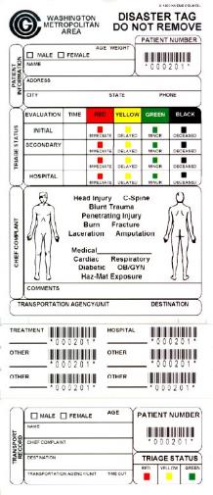
Limitations of Scoring Systems
MCI settings tend to be chaotic and unstable
Outcomes are improved with accurate and rapid triage
Scoring systems, although universally used have limited accuracy and reliability
Notes:
Furthermore, MCI
settings tend to be chaotic and frequently lack a stable environment
or organized infrastructure [25 –29 ], which may
further impede care. Consequently, patient survival during
an MCI depends on the ability of responders to rapidly and
accurately triage patients to the appropriate level of care.
Most currently applied triage schemes rely on history and
physical examination, both of which can be unreliable and/
or difficult to obtain in MCI settings [17 , 30 –34 ]. Use of an
adjunct that facilitates this triage process may be the key to
potentially improving care, and thus survival, during MCIs
[10 , 30 , 32 , 35 –37 ].
Ultrasound portability

Slide 18
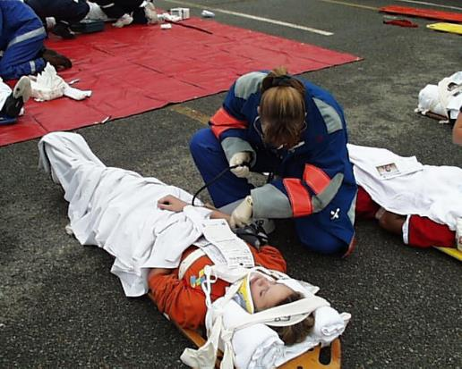
Disaster Triage
Central to the triage of disaster victims is ensuring that each patient is assigned a care priority level corresponding to the presence of treatable life-threatening conditions, without committing precious resources on those not likely to survive
Notes:
Central to the triage of disaster victims is ensuring that
each patient is assigned a care priority level corresponding
to the presence of treatable life-threatening conditions,
without committing precious resources on those not likely
to survive (Table 2 ). Effective care during an MCI requires
the optimal balance of resources, care given, urgency of
care, and ability to achieve a meaningful outcome. Consequently,
rapidly and accurately determining who will
benefit from what intervention is at the forefront of MCIs.
Developing an effective triage process and related training
has been the focus of numerous initiatives [10 , 82 –84 ].

Slide 19
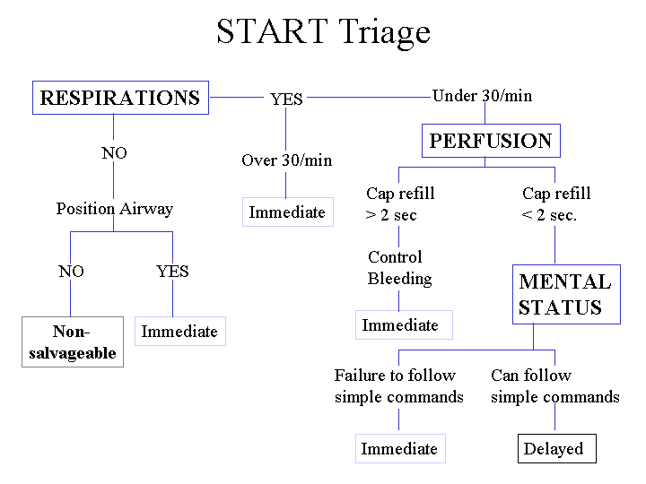
Current State
Current triage protocols depend heavily on history and physical examination to determine care priority, the most common of which assigns a color-coded priority status based on vital signs, and ability to ambulate and phonate

Slide 20
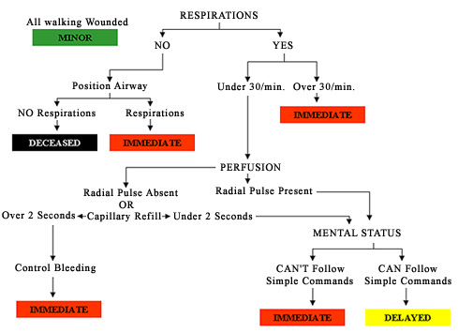
Simple Triage and Active Treatment

Slide 21
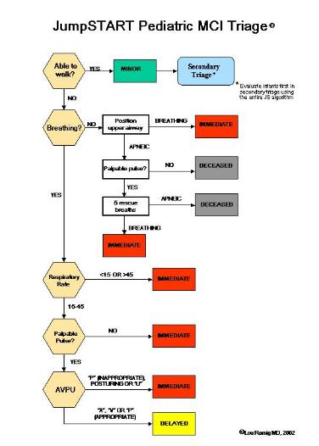
JumpSTART Pediatric MCI Triage

Slide 22
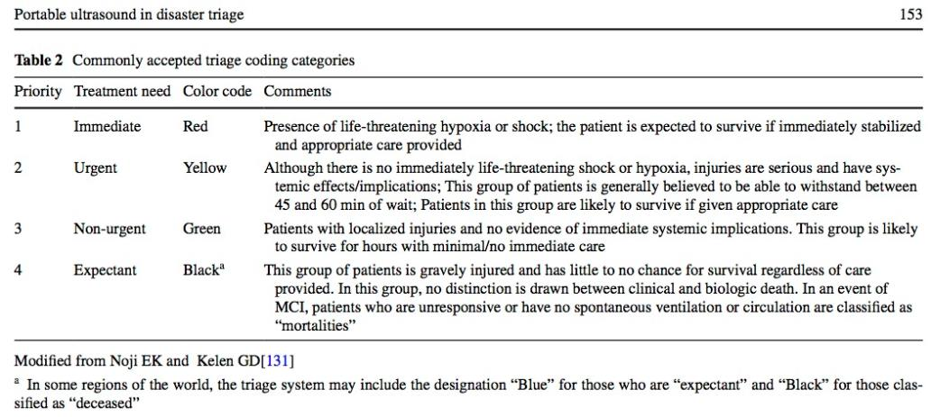
Categories

Slide 23
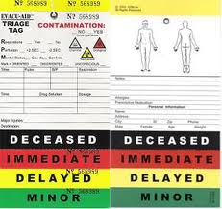
Red
“Red” patients are those with immediately life-threatening hemodynamic alteration, but are perceived as salvageable if given appropriate attention.
Notes:
has been the focus of numerous initiatives [10 , 82 –84 ].
Current triage protocols depend heavily on history and
physical examination to determine care priority, the most
common of which assigns a color-coded priority status
based on vital signs, and ability to ambulate and phonate
(Table 2 ) [85 ]. “Red” patients are those with immediately
life-threatening hemodynamic alteration, but are perceived
as salvageable if given appropriate attention. “Yellow”
patients are perceived to have injuries that are not immediately
life-threatening, but are anticipated to have systemic
effects within a brief time interval (i.e., 45–60 min) and
need urgent medical attention. “Green” patients have perceived
injuries that are localized and not anticipated to have
systemic impact, or the development of systemic effects
is anticipated to be delayed by hours. “Black” patients are
described as “expectant” or “dead” [86 ]. These patients
have a poor chance of survival, even if appropriate medical
care is administered. For practical reasons, unresponsive
patients without evidence of circulation or spontaneous
ventilation are considered to be

Slide 24
Yellow
“Yellow” patients are perceived to have injuries that are not immediately life-threatening, but are anticipated to have systemic effects within a brief time interval (i.e., 45–60 min) and need urgent medical attention.

Slide 25
Green
. “Green” patients have perceived injuries that are localized and not anticipated to have systemic impact, or the development of systemic effects is anticipated to be delayed by hours

Slide 26
Black
“Black” patients are described as “expectant” or “dead” . These patients have a poor chance of survival, even if appropriate medical care is administered.
For practical reasons, unresponsive patients without evidence of circulation or spontaneous ventilation are considered to be deceased, and are treated last or not at all

Slide 27
Limitations
Overtriage
  The provision of resources to patients which eventually are determined to have minor issues that may not require the amount of effort originally allocated
Undertriage
  The patient does not receive the care required to prevent physiologic deterioration or death and is usually due to the failure to recognize life-threatening medical problems or injuries

Slide 28
Assessment of Triage Instruments
MCIs are by definition inherently difficult to study
Real world estimates;
  Overtriage: 7-12%
  Undertirage: 4-15%
Simulations:
  Overtriage: 16%
  Undertriage: 24%
Overall accuracy of triage approximately 61%
Limited by repeated triage assessment
Notes:
As noted in our previous
discussion, MCIs are inherently difficult to study and
the ability to determine under- and overtriage rates may be
very limited at best [94 ]. Previously reported data suggest
7–12 % rates for overtriage and 4–15 % rates for undertriage
[95 , 96 ]. Investigations of simulated MCIs have shown
rates of 16 and 24 %, respectively [86 ]. Kleber et al. [86 ]
also noted limited accuracy (61 %) of in-hospital triage,
which they attributed to insufficient training. In response,
many

Slide 29
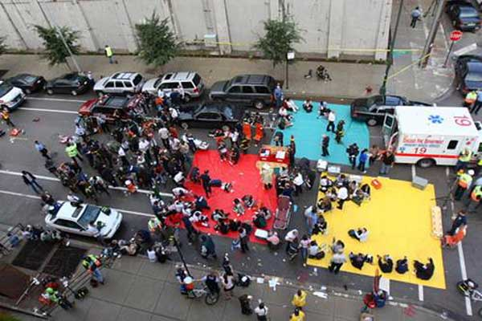
The Best Tools
No MCI primary triage tool has been validated by outcome data from MCIs.
Mass-casualty triage: Time for an evidence-based approach. Jenkins JL, McCarthy ML, Sauer LM, Green GB, Stuart S, Thomas TL,
Hsu EB Prehospital Disast Med 2008;23(1):3–8

Slide 30
Israeli Model
Little to no triage done on-scene
“Save and run” philosophy
Very hazardous scenes
Reds to closest hospital
Nearest hospital becomes triage center?
Uses physicians as triage officers
  Accuracy of physician triage called into question
Metropolitan Israeli hospitals may be more uniformly capable of caring for trauma victims than in many areas of the US

Slide 31
START Triage

Slide 32
START STEP 1
Triage officer announces that all patients that can walk should get up and walk to a designated area for eventual secondary triage.
All ambulatory patients are initially tagged as Green.

Slide 33
START STEP 2
Triage officer assesses patients in the order in which they are encountered
Assess for presence or absence of spontaneous respirations
  If breathing, move to Step 3
  If apneic, open airway
  If patient remains apneic, tag as Black
If patient starts breathing, tag as Red

Slide 34
START STEP 3
Assess respiratory rate
If ≤30, proceed to Step 4
If >30, tag patient as Red

Slide 35
START STEP 4
Assess capillary refill
If ≤ 2 seconds, move to Step 5
If >2 seconds, tag as Red

Slide 36
START STEP 5
Assess mental status
If able to obey commands, tag as Yellow
If unable to obey commands, tag as Red

Slide 37
START SHORTCUT
R
P
M
30
2
Can do

Slide 38
Ultrasound Triage in Civilian MCI
Mazur SM, Rippey J. Transport and use of point-of-care ultrasound by a disaster medical assistance team. Prehosp Disaster Med. 2009;24(2):140–4.
Shorter M, Macias DJ. Portable handheld ultrasound in austere environments: use in the Haiti disaster. Prehosp Disaster Med. 2012;27(2):172–7.
Ma OJ, Norvell JG, Subramanian S. Ultrasound applications in mass casualties and extreme environments. Crit Care Med. 2007;35(5 Suppl):S275–9.
Zhang S, et al. Utility of point-of-care ultrasound in acute management triage of earthquake injury. Am J Emerg Med. 2014;32(1):92–5.

Slide 39
Thirty Years Ago
Sarkisian AE, et al. Sonographic screening of mass casualties for abdominal and renal injuries following the 1988 Armenian earthquake. J Trauma. 1991;31(2):247–50.
  Demonstratated during the 1998 Armenian earthquake that the average time spent on a single patient with ultrasound was 4 min; there were no false-positive examinations with few (1 %) false negatives

Slide 40
Zhang S, et al. Utility of point-of-care ultrasound in acute management triage of earthquake injury. Am J Emerg Med. 2014;32(1):92–5.
  Ultrasound use following the Wenchuan earthquake disaster in 2008 reported sensitivity of 91.9 % and specificity of 96.6 % for the diagnosis of abdominal injuries
Notes:
Ultrasound use following the Wenchuan earthquake disaster
in 2008 reported sensitivity of 91.9 % and specificity
of 96.6 % for the diagnosis of abdominal injuries

Slide 41
Ultrasound Triage in Military MCI
Kolkebeck T, Mehta S. The focused assessment of sonography for trauma (FAST) exam in a forward-deployed combat emergency department: a prospective observational study. Ann Emerg Med. 2006;48(4):S87.
  Data from ultrasound use during the Iraq conflict demonstrate a high sensitivity and specificity in identifying injuries sustained from both blunt and penetrating trauma, as confirmed by later computed tomography (CT) scans

Slide 42
Fracture Detection
Vasios WN, et al. Fracture detection in a combat theater: four cases comparing ultrasound to conventional radiography. J Spec Oper Med. 2010;10(2):11–5.
Vasios WN, et al. Fracture detection in a combat theater: four cases comparing ultrasound to conventional radiography. J Spec Oper Med. 2010;10(2):11–5.

Slide 43
CAVEAT Protocol
The CAVEAT Protocol is a suggested complement
to existing triage schemes.
Perform the CAVEAT in the following order to identify most immediately life-threatening pathology first.
  Chest
  Abdomen
  Central venous assessment
  Extremities
Notes:
The first maneuver in the performance of the
CAVEAT is an examination of the pleura to identify pneumothorax.
Second, a complete FAST examination is performed,
with the addition of views of the bilateral costophrenic
angles to identify hemothorax. Next, the central
venous status is assessed, looking mainly for the degree of
observable collapsibility. Research shows that visual estimation
of venous collapsibility provides results comparable
to those of caliper-based calculations [130 ]. Lastly, the
extremities are imaged, with attention paid to the areas of
tenderness, deformity or abnormality on physical examination.
Again, the extremity exam need not be performed at
the same time as the chest and abdominal images, and can
be deferred based on the sonographer’s skill, urgency of
the situation, and resources available at the time of evaluation
[17 ]. Consequently, the central venous and extremity
assessments can be considered to constitute “secondary triage”
procedures, while the other components of CAVEAT
would be considered to be “primary triage” steps.

Slide 44
CHEST
Evaluate pleura to identify pneumothorax.
Addition of views of the bilateral costophrenic angles to identify hemothorax added to FAST exam

Slide 45
ABDOMEN
FAST exam including bilateral costophrenic angles

Slide 46
CENTRAL Venous
The central venous status is assessed, looking mainly for the degree of observable collapsibility.
Research shows that visual estimation of venous collapsibility provides results comparable to those of caliper-based calculations

Slide 47
EXTREMITIES
The extremities are imaged, with attention paid to the areas of tenderness, deformity or abnormality on physical examination.
The extremity exam need not be performed at the same time as the chest and abdominal images, and can be deferred based on the sonographer’s skill, urgency of the situation, and resources available at the time of evaluation

Slide 48
CAVEAT

Slide 49
Limitations
The CAVEAT examination is not designed to identify injuries of the retroperitoneum, intracranial, or pelvic areas.
It is not intended to provide specific anatomic detail.
Other injuries that may be missed include those of the great vessels or hollow viscus, if the injury does not result in hemoperitoneum.
Other limitations of the CAVEAT examination include the training of the sonographer and interpreter of the images

Slide 50
Conclusion
Primary Triage
  Physiologic-based instruments
Secondary Triage
  Ultrasound will change everything
  Identify injuries and compensation

Slide 52
The Future…...

Slide 53
Primary Disaster Triage
START and other tools limited but can be widely applied by multiple providers in an MCI
START and other PHYSIOLOGY based tools likely to remain essential Primary Triage

Slide 54

Secondary Disaster Triage
Goal is to distinguish between:
  Victims needing life-saving treatment that can only be provided in a hospital setting.
  Victims needing life-saving treatment initially available on scene.
  Victims with moderate non-life-threatening injuries, at risk for delayed complications.
  Victims with minor injuries.
Ultrasound will likely become a valuable part of secondary triage

Slide 55
Conclusion
In particular, sonography has been found capable of rapidly and accurately diagnosing life-threatening injuries including intraperitoneal hemorrhage, hemopericardium, hemothorax, pneumothorax, and states of hypovolemia due to significant blood loss.
Practitioners skilled in the use of ultrasound can use the CAVEAT exam to rapidly assess injured patients. Each of the components of the CAVEAT exam has been independently validated and, when combined, can serve as a useful tool in the rapid assessment of injured patients.

Slide 56
The Future is….NOW!
Thank you!

