Slide 1
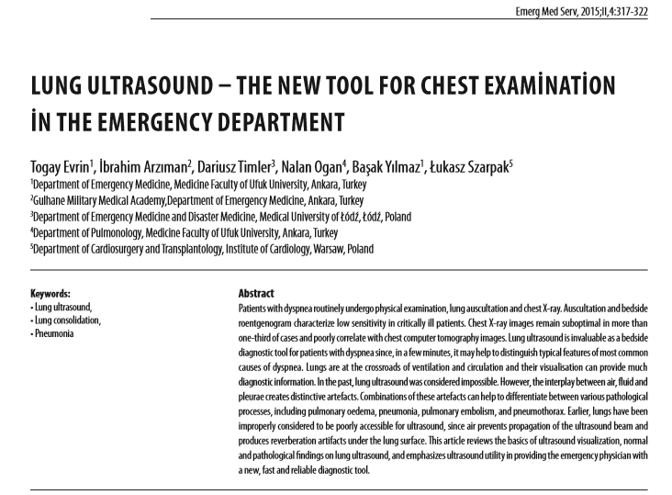
Akciğer Fizik Muayenesinde Yeni Bir Yöntem:
AKCİĞER ULTRASONOGRAFİSİ
Yrd.Doç.Dr. Togay EVRİN
Ufuk Üniversitesi Acil Tıp AnaBilim Dalı

Slide 2
USG
Günümüzde acil servislerde kullanımı hızla artan bir tanı aracı olarak karşımıza çıkmaktadır.
Girişimsel (periferik blok , santral damar yolu ,LP )
FAST , BLUE , Yabancı Cisim , CVP, Acil Kardiyak USG , Havayolu USG , Akciğer USG…….
Lüks ------- ihtiyaç ------- olmazsa olmaz

Slide 3
Akciğer USG
Nefes Darlığı (ASY) (acil servis)
Fizik Muayene , X ray , Biyokimya
USG (non-invaziv , taşınabilir , kolay kullanılabilir) BLUE , RUSH ,SESAME , FALL….
.Critical care ultrasound in cardiac arrest. Technological requirements for performing the SESAME-protocol - a holistic approach. Lichtenstein D, Malbrain ML.Anaesthesiol Intensive Ther. 2015;47(5):471-81.
. Lung ultrasound in acute respiratory failure an introduction to the BLUE-protocol. Lichtenstein . 2009 May;75(5):313-7 May;75(5):313-7.
.BLUE-protocol and FALLS-protocol: two applications of lung ultrasound in the critically ill. Lichtenstein . Chest 2015 Jun;147(6):1659-70.
.Relevance of lung ultrasound in the diagnosis of acute respiratory failure: the BLUE protocol Lichtenstein . Chest 2008 Jul;134(1):11725

Slide 4
USG
Hızlı , pratik
Süregelen
Hasta Transport – yatak başı
Çocuklar ve hamileler (radyasyon)
Yoğun bakım , intraoperatif

Slide 5
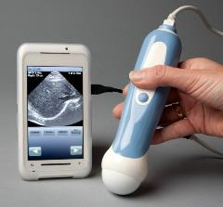
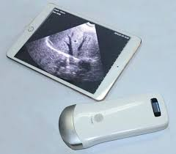
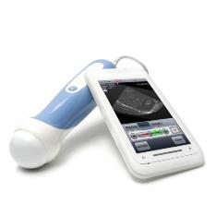
USG

Slide 6
USG
Fizik Muayene ile eş zamanlı
Öksürük , travma , nefes darlığı ,hemoptizi …
Akciğer muayenesinin bir parçası
plevra, akciğerler, göğüs duvarı , mediasten ve diyafram görsel olarak değerlendirme imkanı sunduğu için öne çıkmaktadır.

Slide 7
Akciğer USG
Akciğer iç organlarımız arasında en çok hacime sahip organdır; yüzey alanı 1500 cm² olan bu organı incelerken probu nereye koyalım?
“Steteskopu nereye koyuyorsak probu da oraya koyabiliriz”(sarı alan ve yeşil alan)
Kritik hasta bakısında bize zaman çok daha değerli olduğu için BLUE , PLAPS protokolleri önerilse de.

Slide 8
USG Cihazları ve Probları
Her türlü usg cihazı ile akciğer usg’si yapılabilir.
Taşınabilir , hafif ve küçük
M mode
Power Doppler
Lineer Prob
Konveks Probda

Slide 9
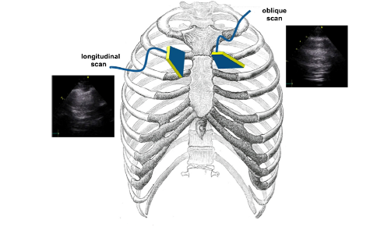
USG Teknik
Steteskopu nereye koyuyorsak probu da oraya koyabiliriz

Slide 10
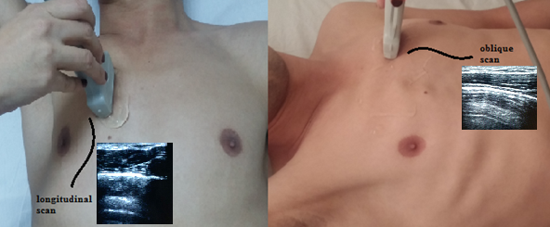
USG Teknik
bat-sign
(the wings of the bat)
Üst ve alt kot

Slide 11
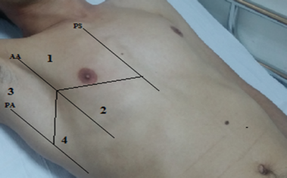
USG Teknik
Eight-zone scanning scheme of the antero-lateral chest(PS:parasternal,AA:Anterior axillary,PA:Posterior axillary
ASY ‘ de , 2 bölgenin hızlı usg bakısı intersisyel akciğer hastalığı ve kardiyojenik akut pulmoner ödemi dışlamada yeterlidir.

Slide 12
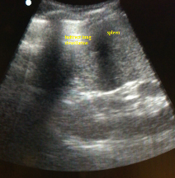
USG Teknik
her iki costaphrenic sinus
Konveks prob
Subdiyafragmatik organlar (kc ve dalak)
en ideali oturur pozisyonda , axiller hattan

Slide 13
Artefakt ve Normal Bulgular
Plevra 0.2 to 0.4 mm , hiper ekoik çizgi 0,5 cm kot altında
lung sliding ( amplitude of the lung sliding is minimal at the apices and maximal at the bases)
The sea-shore sign (M mode)
Horizontal lines
B lines

Slide 14
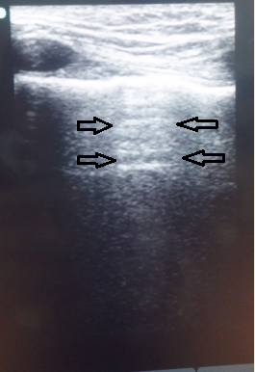
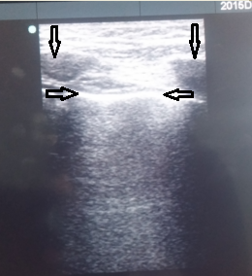
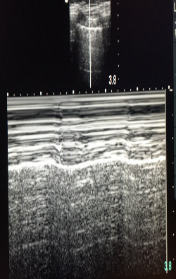
Artefakt ve Normal Bulgular

Slide 15
Plevral Efüzyon
USG hem akciğer oskültasyonu hem de x raye göre plevral effüzyonu tanısal doğrulamada daha etkin.
Lichtenstein D, Goldstein I, Mourgeon E, Cluzel P, Grenier P,Rouby JJ: Comparative diagnostic performances of auscultation, chest radiography and lung ultrasonography in acute respiratorydistress syndrome. Anesthesiology 100, 9–15 (2004)
Xray Ortastatik pozisyonda effüzyon en az 200 mL supin pozisyonda duyarlılık daha da azalır.
USG 20 ml sıvıyı değerlendirebilir
Blackmore CC, Black WC, Dallas RV, Crow HC. Pleural fluid volume estimation: a chest radiograph prediction rule. Acad Radiol. 1996;3(2):103-9.
Lichtenstein D, Goldstein I, Mourgeon E, Cluzel P, Grenier P,Rouby JJ: Comparative diagnostic performances of auscultation, chest radiography and lung ultrasonography in acute respiratorydistress syndrome. Anesthesiology 100, 9–15 (2004)

Slide 16
Plevral Efüzyon
Efüzyonun karakteristiğine göre transuda ve eksüda ayrımı yapılabilir.
Anekoik (siyah)
Kompleks septasız (siyah içinde beyaz ekoik fibrin)
kompleks septalı (siyah içinde beya septalar),

Slide 17
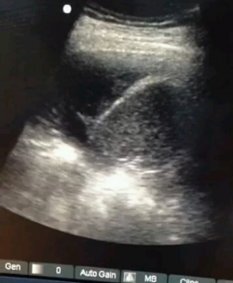
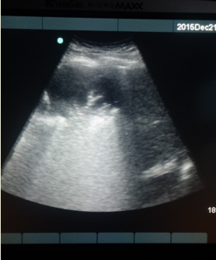
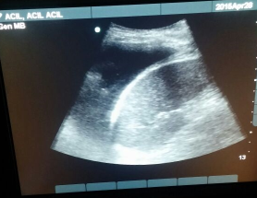
Plevral Efüzyon

Slide 18
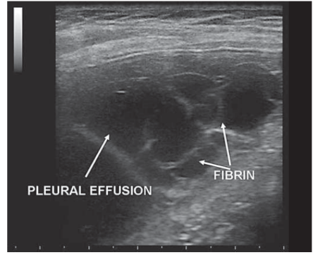
Plevral Efüzyon
Ampiyem bal peteği görünümü

Slide 19
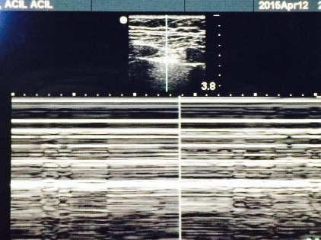
Pnömotoraks
stratosphere sign
Lung point
Lung sliding azalması

Slide 20
Pnömotoraks
Lung point pnömotoraks için %100 tanı koydurucu
lung sliding jet or high-frequency ventilation, masif atelektazi , plevral fibrosis, frenik sinir paralizisi, cardiopulmonary arrest, apne

Slide 21
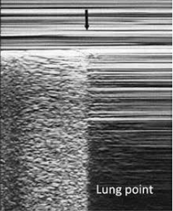
Pnömotoraks

Slide 22
Pnömoni
USG sensitivite (94%) and spesifisite(96%)
Miguel A Chavez, Navid Shams, Laura E Ellington1,et al, Lung ultrasound for the diagnosis of pneumonia in adults: a systematic review and meta-analysis Respiratory Research 2014, 15:50

Slide 23
Pnömoni
Hipoekoik alanlar(fluid bronkogram)
Düzensiz ,çıkıntılı akciğer sınırları
Hava bronkogram
Pleural effusion
Vascular akım konsolide akciğer alanında ( color or power Doppler imaging)
Akciğeride hepatizasyon bulgusu
Michael Blaivas Lung Ultrasound in Evaluation of Pneumonia J Ultrasound Med 2012; 31:823–826

Slide 24
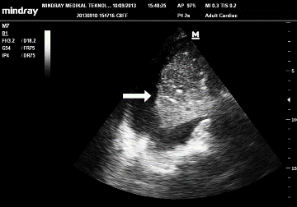
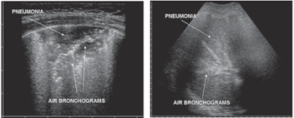
Pnömoni
White arrow shows air bronchograms in tissue-like sonographic pattern of lung
a the presence of consolidation with evidence of air bronchograms, b Air bronchograms are seen in the infected area as branching echogenic structures

Slide 25
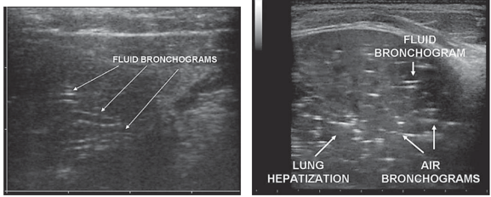
Pnömoni
a Fluid bronchograms, which are frequently observed in post obstructive pneumonia, appear as anechoic tubular structures with hyperechoic walls without any color Doppler signal, b LUS reveals air and fluid bronchograms within the affected area

Slide 26
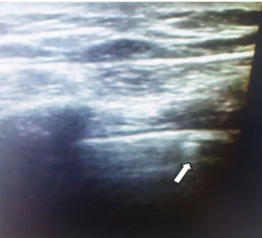
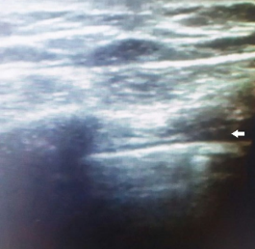
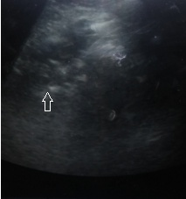
Fluid bronchograms, which are frequently observed in post obstructive pneumonia, appear as anechoic tubular structures with hyperechoic walls
Pnömoni

Slide 27
Intersisyel Sendrom ve Akut Pulmoner Ödem
LUNG ROCKETS
sensitivite pulmonary ödem 100% and spesificite 92%
sensitivite ve spesifite 93% Intersisyel Sendrom
LUNG ROCKETS
Angelika Reissig ,Roberto Copetti Lung Ultrasound in Community-Acquired Pneumonia and in Interstitial Lung Diseases Respiration 2014;87:179–189

Slide 28
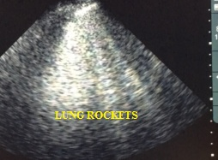
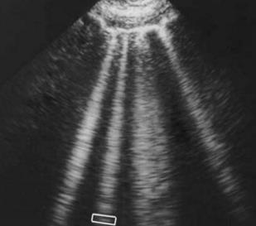
Lung Rockets
Lung rockets , horizontal A lines yok

Slide 29
Göğüs Duvarı
Kot ve sternum fraktürleri (hematom ya da deplase)
Pnömotoraks ve hemotoraks (komplike)
Diyafram (travmaya bağlı rüptür , paralizi KOAH sınıflandırması)

Slide 30
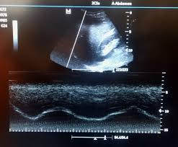
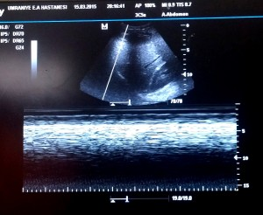
Göğüs Duvarı

Slide 31
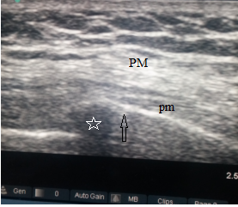
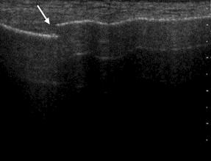
Göğüs Duvarı
( Rib fracture) Diagnostic US in the longitudinal plane of a rib consistent with a fracture and surrounding hematoma (asterisk) displacing the overlying pectoralis minor muscle (pm) and a portion of the pectoralis major muscle (PM

Slide 32
Sınırlar
Obezite
Kişi bağımlı
Amfizem
Sol kostofrenik sinüs

Slide 33
Sonuç
Güvenilir , kolay ,ucuz tanısal bir araç
Radyasyon
Transport
Yeni USG cihazları akciğer muayenesi

Slide 34
Referanslar
1. Lichtenstein D, Goldstein I, Mourgeon E, Cluzel P, Grenier P,Rouby JJ: Comparative diagnostic performances of auscultation, chest radiography and lung ultrasonography in acute respiratorydistress syndrome. Anesthesiology 100, 9–15 (2004)
2. Koenig SJ, Narasimhan M, Mayo PH. Thoracicultrasonography for the pulmonary specialist. Chest.2011;140(5):1332-41. http://dx.doi.org/10.1378/chest.11-0348
3. Nazarian LN. The top 10 reasons musculoskeletal sonography is an important complementary or alternative technique to MRI. AJR Am J Roentgenol. 2008;190:1621-6.
4. Volpicelli G, Elbarbary M, Blaivas M, Lichtenstein DA,Mathis G, Kirkpatrick AW, et al. International evidencebasedrecommendations for point-of-care lung ultrasound.Intensive Care Med. 2012;38(4):577-91.
5. Lichtenstein DA, Mezière GA. Relevance of lung ultrasound in the diagnosis of acute respiratory failure: the BLUE protocol. Chest. 2008;134:117-25.
6. Lichtenstein DA. Point-of-care ultrasound: infection control in the intensive care unit. Crit Care Med. 2007;35:S262-S7.
7. Mathis G. Thoraxsonography – Part I: chest wall and pleura. Ultrasound. Med Biol. 1997;23:1131-9.
8. Lapostolle F, Petrovic T, Lenoir G, Catineau J, Galinski M, Metzger J, et al. Usefulness of hand-held ultrasound devices in out-of-hospital diagnosis performed by emergency physicians. J Emerg Med. 2006;24:237-42.
9. Knudsen CW et al (2004) Diagnostic value of B-type natriureticpeptide and chest radiographic findings in patients with acutedyspnea. Am J Med 15:363–368
10. Onwuanyi A et al (2007) Acute decompensated heart failure:pathophysiology and treatment. Am J Cardiol 99(6B):25D–30D
11. Studler U et al (2008) Accuracy of chest radiographs in theemergency diagnosis of heart failure. Eur Radiol 18:1644–1652
12. Jambrick Z et al (2004) Usefulness of ultrasound lung comets as nonradiologic sign of extravascular lung water. Am J Cardiol 93:1265–1270
13. Volpicelli G, Frascisco M: Lung ultrasound in the evaluation of patients with pleuritic pain in the emergency department. J Emerg Med 2008, 34:179–186
14. Luna Gargani , Giovanni Volpicelli How I do it: Lung ultrasound Cardiovascular Ultrasound 2014, 12:25
15. Delle Sedie A, Doveri M, Frassi F, Gargani L, D’Errico G, Pepe P, Bazzichi L, Riente L, Caramella D, Bombardieri S: Letter to the editors: Ultrasound lung comets in systemic sclerosis: a useful tool to detect lung interstitial fibrosis. Clin Exp Rheumatol 2010, 28
16.Alfredo Barillari , Massimo Fioretti Lung ultrasound: a new tool for the emergency physician Intern Emerg Med (2010) 5:335–340
17.Lichtenstein D, Meziere G: A lung ultrasound sign allowing bedside distinction between pulmonary edema and COPD: The comet-tail artifact. Intensive Care Med 1998; 24:1331–4
18. Daniel Lichtenstein, Simon van Hooland, Paul Elbers, Manu L.N.G. Malbrain Ten good reasons to practice ultrasound in critical care Anaesthesiology Intensive Therapy 2014, vol. 46, no 5, 323–335
19. Iván Vollmer and Ángel Gayete Chest Ultrasonography Arch Bronconeumol. 2010;46(1):27-34
20. Yu CJ, Yang PC, Wu HD, Chang DB, Kuo SH, Luh KT. Ultrasound study in unilateral hemithorax opacification. Image comparison with computed tomography. Am Rev Respir Dis. 1993;147(2):430-4. http://dx.doi.org/10.1164/ ajrccm/147.2.430
21. Blackmore CC, Black WC, Dallas RV, Crow HC. Pleural fluid volume estimation: a chest radiograph prediction rule. Acad Radiol. 1996;3(2):103-9.
22.Rahman NM, Singanayagam A, Davies HE, Wrightson JM, Mishra EK, Lee YC, et al. Diagnostic accuracy, safety and utilisation of respiratory physician-delivered thoracic ultrasound. Thorax. 2010;65(5):449-53.
23. Lorenz J, Börner N, Nikolaus HP. Sonographic volumetry of pleural effusions.
Ultraschall Med. 1988;9:212-5.
24.Remérand F, Dellamonica J, Mao Z, Ferrari F, Bouhemad B, Jianxin Y, et al. Multiplane ultrasound approach to quantify pleural effusion at the bedside. Intensive Care Med. 2010;36(4):656-64. http://dx.doi.org/10.1007/ s00134-010-1769-9
25. Eibenberger KL, Dock WI, Ammann ME, Dorffner R, Hörmann MF, Grabenwöger F. Quantification of pleural effusions: sonography versus radiography. Radiology. 1994;191:681-4.
26. Elena Prina, Antoni Torres, Carlos Roberto Ribeiro Carvalho Lung ultrasound in the evaluation of pleural effusion J Bras Pneumol. 2014;40(1):1-5
27. Lichtenstein DA, Mezière G, Lascols N, Biderman P, Courret JP, Gepner A, et al. Ultrasound diagnosis of occult pneumothorax. Crit Care Med. 2005;33:1231-8.
28. Miguel A Chavez, Navid Shams, Laura E Ellington1,et al, Lung ultrasound for the diagnosis of pneumonia in adults: a systematic review and meta-analysis Respiratory Research 2014, 15:50
29. Erden Erol Unluer.Arif Karagöz A dynamic sign of alveolar consolidation in bedside ultrasonography: Air bronchogram Interventional Medicine & Applied Science, Vol. 6 (1), pp. 40–42 (2014)
30.Angelika Reissig ,Roberto Copetti Lung Ultrasound in Community-Acquired Pneumonia and in Interstitial Lung Diseases Respiration 2014;87:179–189
31. Miller LD, Joyner CR Jr, Dudrick SJ, Eskin DJ (1967) Clinical use of ultrasound in the early diagnosis of pulmonary embolism. Ann Surg 166:381–393
32. Mathis G, Blank W, Reissig A, Lechleitner P, Reuss J, Schuler A, Beckh S (2005) Thoracic ultrasound for diagnosing pulmonary embolism: a prospective multicenter study of 352 patients. Chest 128:1531–1538
33. Squizzato A, Galli L, Gerdes V. Gerdes Point-of-care ultrasound in the diagnosis of pulmonary embolism Critical Ultrasound Journal (2015) 7:7
34. Griffith JF, Rainer TH, Ching AS, Law KL, Cocks RA, Metreweli C. Sonography compared with radiography in revealing acute rib fracture. AJR Am J Roentgenol. 1999;173:1603-9.
35. Paik SH, Chung MJ, Park JS, Goo JM, Im JG. High-resolution sonography of the rib: can fracture and metastasis be differentiated? AJR Am J Roentgenol. 2005;184:969-74.
36.Baron R, Lee J, Melson G. Sonographic evaluation of right juxtadiaphragmatic masses in children using transhepatic approach. J Clin Ultrasound. 1980;8:156-9.
37.Riccabona M. Ultrasound of the chest in children (mediastinum excluded). Eur Radiol 2008;18:390-9.
38. Gerscovich E, Cronan M, McGahan J, Jain K, Jones CD, McDonald C. Ultrasonographic evaluation of diaphragmatic motion. J Ultrasound Med. 2001;20:597-604.

Slide 35
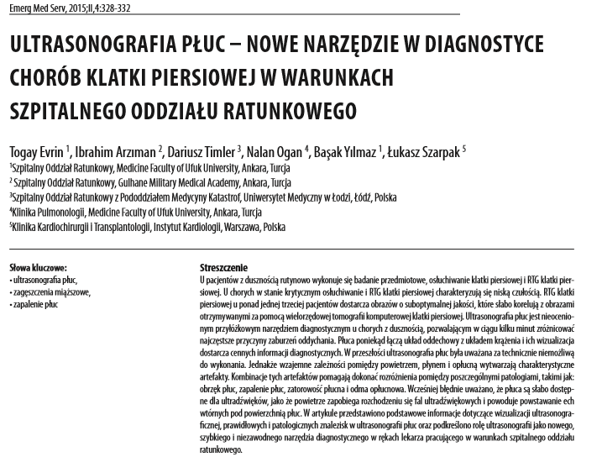
Teşekkürler….

