Slide 1
Dan O’Brien, MD FAAEM, FACEP
Associate Professor Emergency Medicine
University of Louisville School of Medicine
Fire Surgeon, Louisville Division of Fire
SWAT Physician, Louisville Metro Police SWAT Team

Slide 2
The Izmit Earthquake
On August 17, 1999 03:01:37 a.m a massive 7.4 earthquake struck Northern Turkey
Worst Earthquake Disaster of Century
Approximately 40x200 km region centered on Gölcük

Slide 3
Over 15,000 dead
Over 15,000 missing
More than 120,000 homes destroyed
Over 600,000 in need of shelter

Slide 6
Notes:
Although I have spent my career in teaching emergency medicine, practicing in the field with EMS, crewing a medical helicopter as a flight physician, providing medical guidance as fire surgeon to a large Fire EMS system, performing my duties as a SWAT physician or law enforcement officer, I think one of the most pivotal moments in my career was when I along with Dr. Don Walsh and Dr. Jeff Arnold were invited to Dukoz Eylul University in Izmir to collaborate with these remarkable clinicians, now more than 16 years ago!

Slide 8
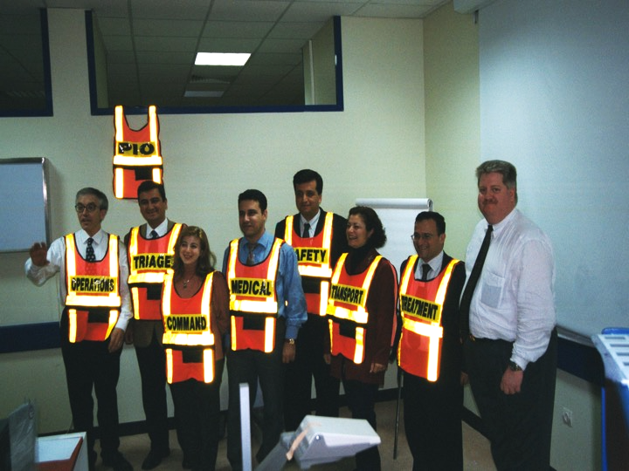
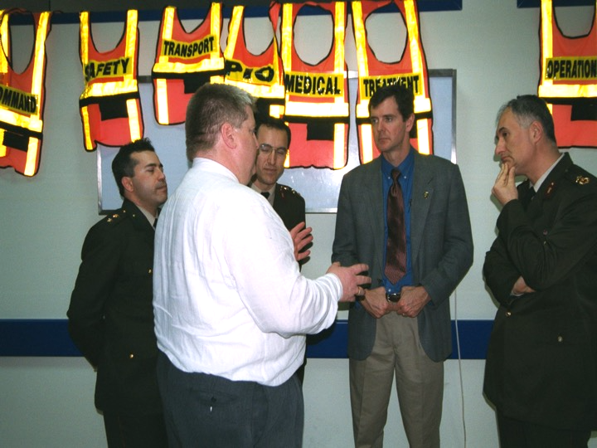

Slide 18
Success!

Slide 19
Turkey is the Epicenter of a New Earthquake…..

Slide 22
Largest mass- migration in the world since World War TWO.
2015 estimates over 2 million registered Syrians
By Sept 2015 Turkey has spent over 7.6 billion dollars
Notes:
Turkey now hosts the largest refugee population in the
world (see Figure 1). The Government of Turkey (GoT) estimates the total number of registered Syrians under Temporary Protection (SuTPs) at 2,225,147.1, 2 Facing a record influx of displaced, the GoT is setting a global precedent for a refugee response with two unique fea- tures:
(i) A non-camp approach. Only 12 percent of the total number of SuTPs are living in tents and temporary shelters;3 the rest are settled in ur- ban areas, where they seek their own accom- modation and work opportunities.
(ii) A government-financed approach. By Septem- ber 2015, the GoT had spent an estimated $7.6 billion on its response to Syrian refugees.

