Slide 1
Rescue Task Force
Dan O’Brien, MD FAAEM, FACEP
Associate Professor Emergency Medicine
University of Louisville School of Medicine
Fire Surgeon, Louisville Division of Fire
SWAT Physician, Louisville Metro Police SWAT Team

Slide 2
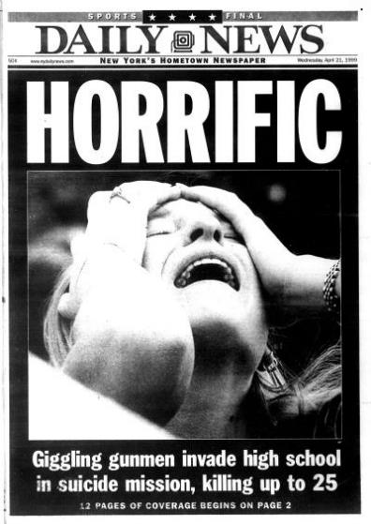
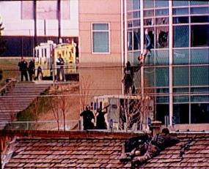
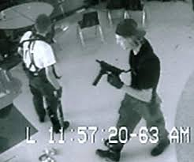
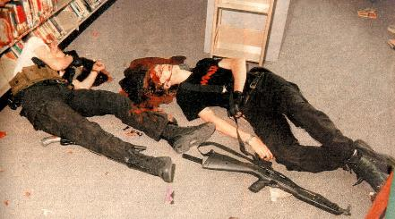
Columbine Colorado 1999

Slide 3
Columbine Timeline
11:17 Harris and Klebold place two 20 pound propane bombs in student cafeteria set to detonate when the cafeteria was full
11:19 Diversionary devices detonate three miles away to divert police and fire response
11:19 Harris and Klebold setup on high ground in front of door anticipated to be used to escape IEDs in order to shoot escaping students. The shooting begins with multiple initial fatalities and injured
11:23 Re enter the cafeteria to determine why IEDs didn't explode. Continued shooting and dispersal of multiple smaller IEDs
11:24 Police arrive on scene with shots exchanged
11:26 request for additional police

Slide 4
Columbine Timeline
11:29 EMS requested
11:33 SWAT enroute
11:36 Command post established
11:38 Reports of pipe bombs detonating in school
11:52 SWAT entry authorized
11:57 First ambulances arrive
12:02 SWAT uses fire truck as shield to approach school
12:05 Fire paramedics arrive at cafeteria, gunfire erupts
12:06 SWAT splits into two teams to clear school
12:08 Harris and Klebold commit suicide

Slide 5
Columbine Timeline
12:10 Medical triage established
12:18 Request ten ambulances and one helicopter
12:31 SWAT continues clearing building
12:50-13:09 SWAT continues clearing and identifies unexploded IEDs
13:57 SWAT continues clearing
15:37 SWAT continues to clear and find victims
16:38 Physician and paramedic escorted by SWAT to triage within the building
16:45 SWAT declares scene secure

Slide 6
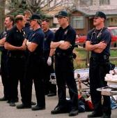
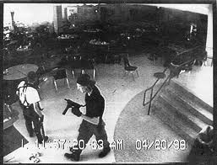
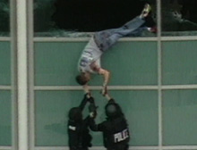
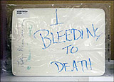
SWAT Response: Prior to Columbine
Columbine High School Shooting – April 20, 1999
  Eric Harris & Dylan Klebold
    Both had self-inflicted fatal wounds
      Occurred within 45 minutes from start of incident
      No significant law enforcement entry for 1 hour
      No medical operations inside for 4 hours
  12 students & 1 teacher killed
  24 wounded
  Coach Dave Sanders
      Bled for > 2hrs before dying

Slide 7
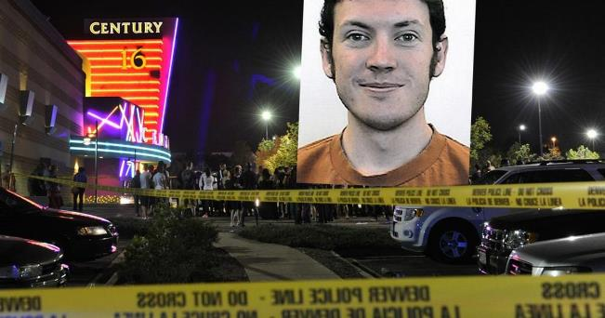
Cinemark Century 16 Theater Aurora, Colorado July 20, 2012
First police car in 83 seconds
Second in 85 seconds
52 cars in 21 minutes
First ambulance in 3 minutes
First fire vehicle in 5 minutes
All victims transported in 55 minutes
12 killed
58 wounded

Slide 8


April 2, 2013
IAFC, IACP, FBI and DHS Host meeting to discuss medical response to active shooter
IAFF, Metro Chiefs and USFA also in attendance
Discussion also covered use of ICS during incidents
Conclusion -“integrated and coordinated planning, policies, training and team building prior to any incident will ensure effective and successful response”

Slide 9
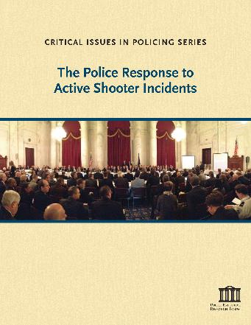
Police Response to Active Shooters 2014
in the Active Shooter event the concept of securing the scene and awaiting SWAT arrival is obsolete
Although SWAT tactics appropriate for hostage scenarios the police response must be faster for Active Shooters
The faster response saves lives but places polices officers at real risk
Police should be trained to expect a fight

Slide 10
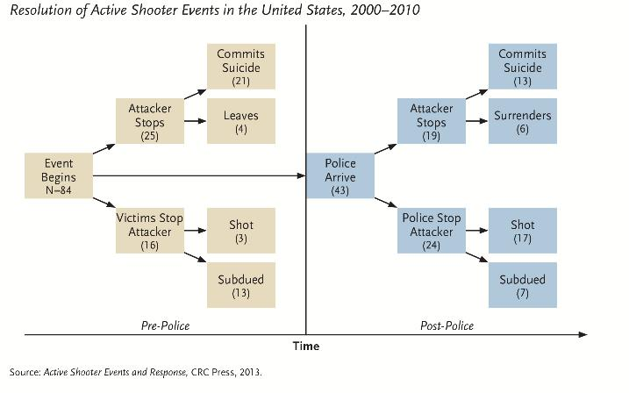
Resolution of Active Shooter Events

Slide 11
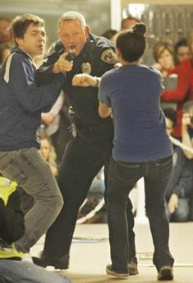
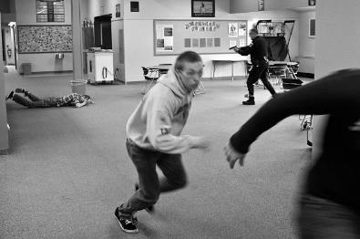
Police Response to Active Shooter
Responding police officer with one simple job; Find the threat and neutralize it

Slide 12
Police Tactics : Entry
Solo entry is dangerous
  75% of the time when a solo officers enters a hot scene the officer takes direct action against the attacker
  ONE-THIRD of all police officers who made entry solo were shot
  62% of the time the officers shoots the attacker
  13% otherwise subdues attacker
Contact teams
Rescue Teams

Slide 13
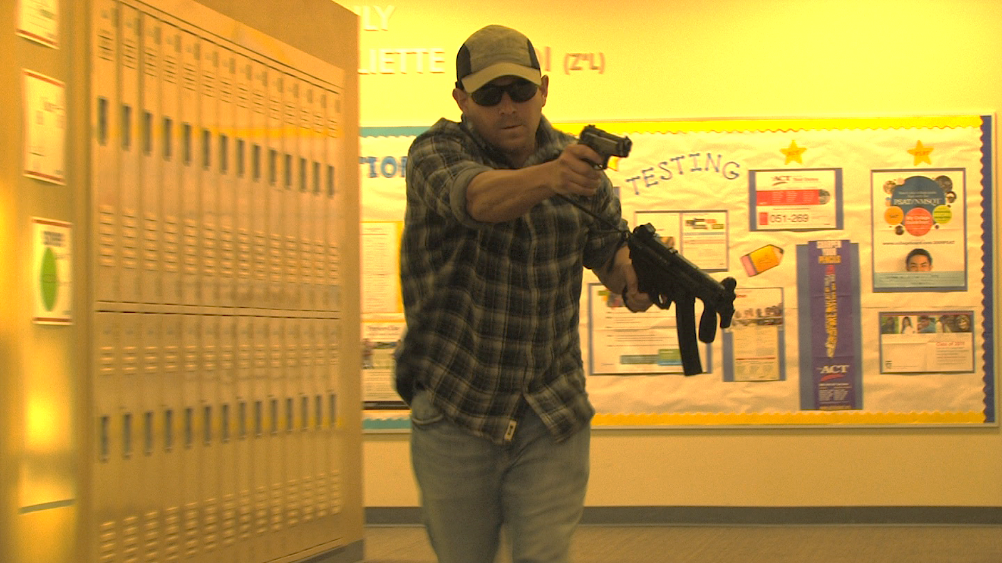
Active Shooter Threat
The agreed-upon definition of an active shooter by U.S. government is “an individual actively engaged in killing or attempting to kill people in a confined and populated area.”
Implicit in this definition is that the subject’s criminal actions involve the use of firearms.

Slide 14
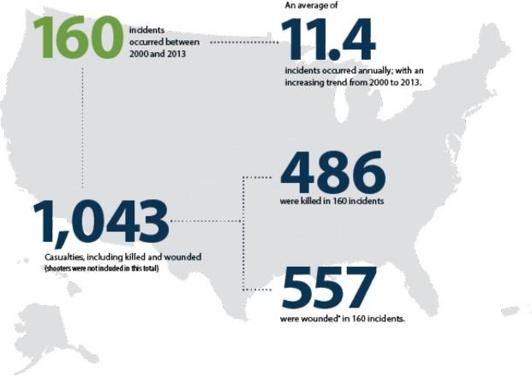
Active Shooter Incidents 2000-2013

Slide 15
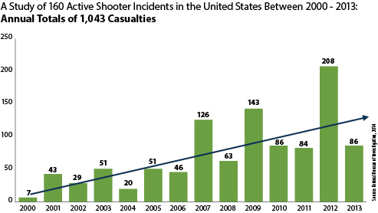
Annual Casualties

Slide 16
Resolutions
23.1% (37of 160) the shooter committed suicide prior to police arrival
  10.6% (17 of 160) committed suicide after police arrival but before police could act
13.1% (21 of 160) unarmed citizens disarmed the shooter
3.1% (5 of 160) shooter was shot by armed citizen
1.3% 2 of 160) off-duty armed police officers killed the shooters
28.1% (45 of 160) exchanged gunfire with police
  25 of 45 killed at scene or other location
  9 wounded
  9 suicide
  2 surrendered
Notes:
Resolutions
The majority of the 160 incidents (90 [56.3%]) ended on the shooter’s initiative— sometimes when the shooter committed suicide or stopped shooting, and other times when the shooter fled the scene.
There were at least 25 incidents where the shooter fled the scene before police arrived. In 4 additional incidents, at least 5 shooters fled the scene and were still at large at the time the study results were released.
In other incidents, it was a combination of actions by citizens and/or law enforcement that ended the shootings. In at least 65 (40.6%) of the 160 incidents, citizen engagement or the shooter committing suicide ended the shooting at the scene before law enforcement arrived. Of those:
In 37 incidents (23.1%), the shooter committed suicide at the scene before police arrived.
In 21 incidents (13.1%), the situation ended after unarmed citizens safely and successfully restrained the shooter. In 2 of those incidents,24 3 off-duty law enforcement officers were present and assisted. Of note, 11 of the incidents involved unarmed principals, teachers, other school staff and students who confronted shooters to end the threat (9 of those shooters were students).
In 5 incidents (3.1%), the shooting ended after armed individuals who were not law enforcement personnel exchanged gunfire with the shooters. In these incidents, 3 shooters were killed, 1 was wounded, and 1 committed suicide. The individuals involved in these shootings included a citizen with a valid firearms permit and armed security guards at a church, an airline counter, a federally managed museum, and a school board meeting.25
In 2 incidents (1.3%), 2 armed, off-duty police officers engaged the shooters, resulting in the death of the shooters. In 1 of those incidents, the off-duty officer assisted a responding officer to end the threat.26
Even when law enforcement arrived quickly, many times the shooter still chose to end his life. In 17 (10.6%) of the 160 incidents, the shooter committed suicide at the scene after law enforcement arrived but before officers could act.
In 45 (28.1%) of the 160 incidents, law enforcement and the shooter exchanged gunfire. Of those 45 incidents, the shooter was killed at the scene in 21, killed at another location in 4, wounded in 9, committed suicide in 9, and surrendered in 2.

Slide 17
Law Enforcement Casualties
Law enforcement suffered casualties in 46.7% (21 of 45) incidents where they engaged the shooter
  9 killed
  28 wounded
Three armed civilians killed
Two unarmed security killed, two wounded

Slide 18
Shooter Outcomes
40% (64 of 160) commit suicide
Only TWO incidents had more than one shooter
3.8% (6 of 160) female
3.8% used body armor
2.5% (5 of 160) carried IED or booby trapped building

Slide 19
Locations
15% (24 of 160) involved more than one location

Slide 20
Location of 160 Active Shooter Incidents

Slide 21
Educational Environments
Virginia Polytechnic Institute and State University, Blacksburg VA
  32 killed
  17 wounded
Sandy Hook Elementary School, Newtown CT
  26 killed
  2 wounded
Northern Illinois University, DeKalb IL
  5 killed
  16 wounded
Santana High School, Santee CA
  2 killed
  13 wounded
Notes:
No law enforcement officers were killed or wounded in school incidents, and no officers were killed in incidents at IHEs. One officer was wounded in 1 incident at an IHE, however, it occurred at a medical facility on the campus and not in a campus residence or classroom.

Slide 22
Incidents
70.0% of the incidents occurred in either a commerce/business or educational environment.10
Shootings occurred in 40 of 50 states and the District of Columbia.
60.0% of the incidents ended before police arrived.

Slide 23
Population 340,000 people

Slide 24
Active Shooter Incidents 2000-2013

Slide 25
Active Shooter Incidents 2000-2013
dd

Slide 26
Active Shooter Incidents 2000-2013
dd

Slide 27
Active Shooter Incidents 2000-2013
dd

Slide 28
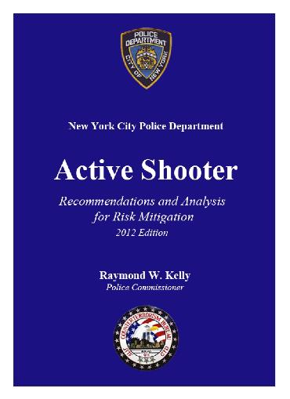
New York Police Department
230 cases (1966-2012)
Event duration
  Average less than TEN minutes
    Most 3-4 minutes
Average police response time
  12-15 minutes
93% of incidents in academic institutions were over prior to the first responding asset, police, fire/EMS arrived on scene

Slide 29
90% of combat deaths occurred prior to medical care
  “The greatest benefit will be achieved through a configuration that puts the caregiver at the patient’s side within a few seconds to minutes of wounding “
  -Wound Data and Munitions Effectiveness Team, 1970

Slide 30
Lessons Learned
The “standard” FIRE/EMS policy to STANDBY until the scene is secure will fail catastrophically in a significant Active Shooter or Paramilitary-style attack.
Organizational paradigms that exclude FIRE and EMS personnel from HOT ZONE operations are naïve and will not stand up to a Mubai or Breslan style attack

Slide 31
Active Shooter Event
After review of combat and post-incident data:
  The immediate threat is rapidly mitigated in almost all incidents well prior to EMS/Fire response
  The sooner the first responders start medical treatment, the greater the chance that victims will survive
  The risk from active shooter incidents is very low in areas that are clear but not secure

Slide 32
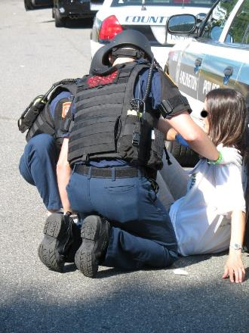
Rescue Task Force
Rapidly provide medical care and stabilize patients in areas that are clear but not secure

Slide 33
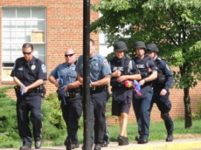
RTF Concept
First arriving EMS personnel (NOT tactical medics) team up with two patrol officers (NOT SWAT) and move quickly into the “warm” zone along cleared areas to initiate treatment and evacuation of victims

Slide 34
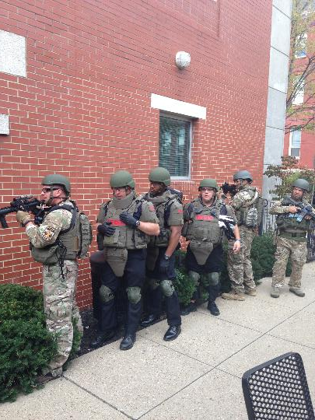
Louisville RTF Concept
First arriving FIRE EMS personnel (NOT tactical medics) team up with two officers (PREFER SWAT) and move quickly into the “warm” zone along cleared areas to initiate treatment and evacuation of victims

Slide 35

Movement
TWO police officers
  ONE front security
  ONE rear security
They DO NOT assist medics with care
Responsible for security & movement ONLY

Slide 36
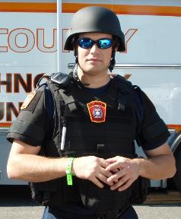
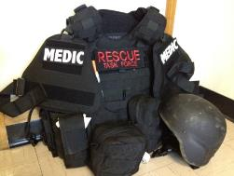
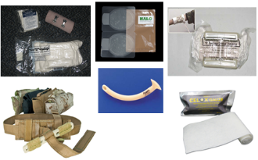
RTF Medic
Fire department personnel
  Outfitted with ballistic gear
  Carry only medical supplies for Tactical Emergency Casualty Care (TECC)
  Tasked with point of wound stabilization and/or victim extrication

Slide 37
Argument Against Paradigm Shift
“Operating in an unsecured environment is too much risk for us to assume!”

Slide 38
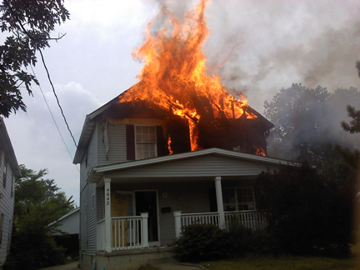
Too Risky?
Responding to a multi-level single family dwelling with fire showing. Mother outside says 2year old is upstairs in back bedroom taking a nap

Slide 39
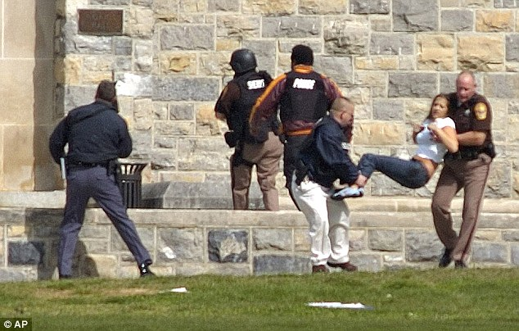
“Police Can Bring Us The Victims”
No care initiated by extracting LE teams
  Can be trained but may create role confusion
  Requires constant maintenance of additional equipment and skill set

Slide 40
“Police Can Bring Us The Victims”
Law enforcement resources need to be carrying out tactical police work
  Poor use of a limited resource
  Searching, clearing, and securing the area requires multiple LE assets
  Need personnel to secure key real estate
    Hallway intersections, stairwells, large open areas
    Outer perimeter control
Trained to move to shooter, not to initiate medical care

Slide 41
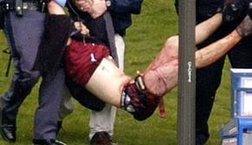
Tactical Medics as the Answer
Are extremely useful if immediately available
  Virginia Tech: Male student shot twice in leg

Slide 42
Tactical Medics as the Answer
BUT are not always readily available
  Typically respond with SWAT team
Have a different dedicated job to do
  Certainly can provide some aid, but as a whole, are dedicated to care for SWAT officers and SWAT mission
Limited resource
  How many medics on team??
  How many patients to be treated??

Slide 43
Medical Management
Tactical Combat Casualty Care
  Tactical COMBAT casualty care (TCCC) is written for the military population working in military scenarios under military scope of practice and liability
  Fails to account for the difference in civilian population and scenario
    Scope of practice variability
    Barriers to evacuation
    Pediatric and geriatric issues
    Baseline health
    Wounding patterns
    Special populations

Slide 44
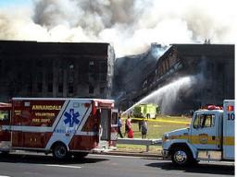
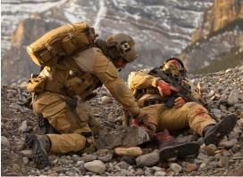
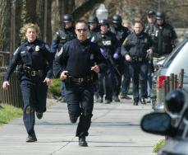
Tactical Emergency Casualty Care
The Civilian version of TCCC

Slide 45
Tactical EMERGENCY Casualty Care
Evidenced-based best practices medical guidelines for care at or near the point of wounding in high risk operations
  NOT Law Enforcement tactical medic specific
  For use by any first responder who is providing medical care whenever and wherever there is increased risk to provider and patient

Slide 46
TECC is “Situation Driven”
Applied differently in each three dynamic phases defined upon the relationship between the injured, the rescuer, and the threat
  Direct Threat Care
  Indirect Threat Care
  Evacuation Care

Slide 47
“We Have Never Done it that Way”
The answer to those who resist changing the paradigm is to address their concerns with:
TRAINING
TACTICS
EQUIPMENT

Slide 48
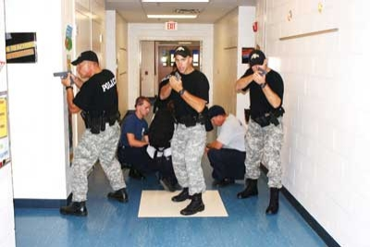
What Do We Know About Fire/EMS?
Brave men and women will likely “go to work” to save others…. AT LEAST we can give them the tools and training to mitigate the risks!

Slide 49
The New EMS/Fire Paradigm
Initial EMS/Fire medical responders should work with Law Enforcement assets to rapidly deploy into areas that have been cleared but not secured to initiate treatment and effect rescue of injured victims
Details
  NOT tactical medics but first arriving EMS assets
  Security provided by LE teams
  Requires appropriate equipment and PPE
  Should utilize TECC medical principles

Slide 50
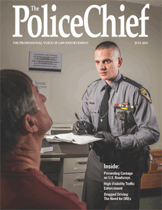
International Association of
Chiefs of Police
“First responders must prepare for, protect against, and respond to these threats collectively because not planning for the event will find responders fighting them together unprepared.”
The Police Chief, July 2013

Slide 51
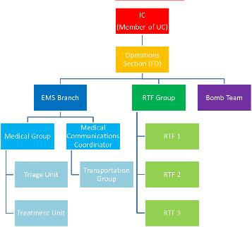

International Association of
Fire Fighters
Use of the National Incident Management System (NIMS) in particular the Incident Command System (ICS).
Use of nationally accepted standards and operational
Use of the Rescue Task Force (RTF) concept for on scene response:
  These teams treat, stabilize, and remove the injured in a rapid manner, while wearing Ballistic Protective Equipment (BPE) and under the protection of a Police Department (PD). An RTF team should include at least one ALS provider.
Police and Fire Departments should train together. Initial and ongoing training and practice are imperative to successful operations.
Use of common communications terminology.

Slide 52
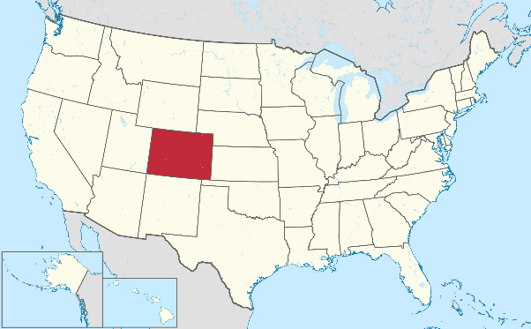
Aurora Colorado

Slide 53
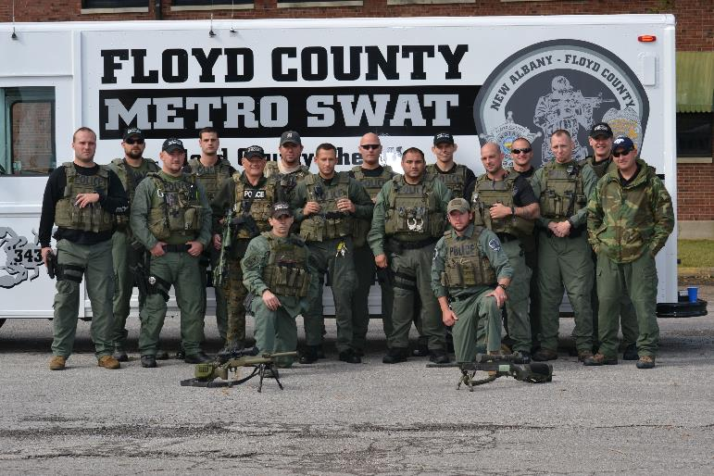
Thank you!

